Slide 1
Dissecting Conglomerate Valuations
Oliver Boguth, Ran Duchin, and Mikhail Simutin (2022)
Presented by Nicholas Thompson

Slide 2
Research question
How can we estimate the Tobin’s Q of conglomerate divisions without relying on standalone firms?
Using these estimates, what are the differences between conglomerates and standalone firms?

Slide 3
Prior Literature
Conglomerate Valuations:
Lang and Stulz (1994) and Berger and Ofek (1995) introduced the concept of “diversification discount” using standalone Qs to assess conglomerate divisions.
Maksimovic and Phillips (2002) and Gomes and Livdan (2004) proposed models with different Qs for conglomerates and standalone firms.
Internal Capital Markets: There is an important role of capital reallocation inside conglomerates in the presence of external financial frictions (e.g., Alchian (1969), Weston (1970), Stein (1997), Hadlock, Ryngaert, and Thomas (2001), Matsusaka and Nanda (2002), Matvos and Seru (2014)).
Measurement Limitations: Traditional approaches rely on standalone firms to proxy divisional Qs, missing intraconglomerate linkages and economic differences.
Notes:
Diversification discount: Conglomerates are often valued lower than the sum of their parts.
The notion of the diversification discount is subject to endogeneity concerns, as the decision to diversify may itself be influenced by factors such as firm characteristics, managerial ability, or investment opportunities that simultaneously affect firm valuation.

Slide 4
Data
Data Source:
Compustat: Firm-level accounting variables and SIC industry classifications.
Compustat Segment files: Division-level variables.
Sample Details:
Period: 1978–2018
Firms with multiple divisions (excluding financial, agricultural, and governmental).
Focus on U.S. conglomerates diversified across different Fama-French industries.

Slide 5
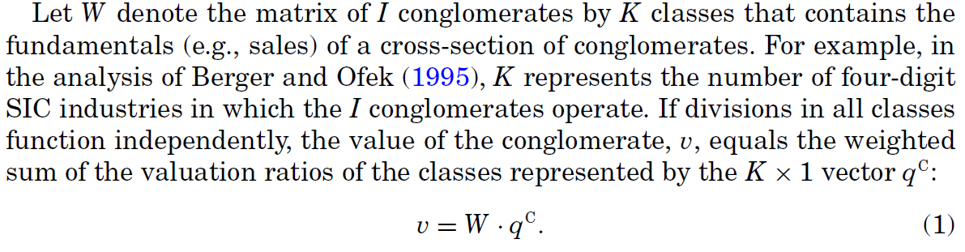
Notes:
v: Total value of the conglomerate.
W: The matrix containing conglomerate exposure to different industries.
q^C: The vector of industry-specific valuation ratios (Tobin’s Q) for each industry.
Key insight: Traditional methods sum up the valuation of each conglomerate division based on standalone industry valuations, which might ignore how divisions are interconnected.

Slide 6
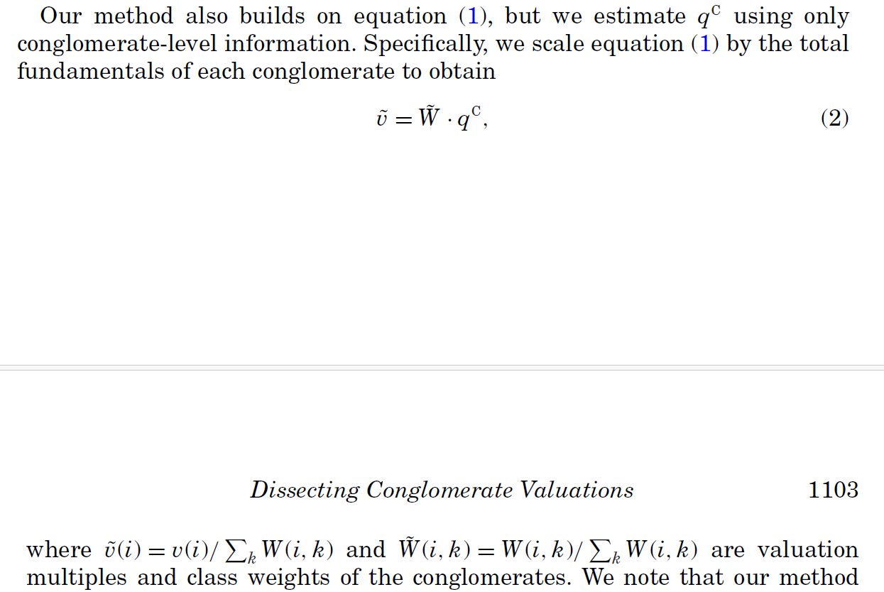
Notes:
Only uses conglomerate-level data, not standalone firm data.
𝑣~(𝑖): Value of the conglomerate scaled by the sum of fundamentals.
W~(i,k): Fundamentals of each division are scaled by the total conglomerate fundamentals.
Key insight: Rather than building up synthetic conglomerates from individual pieces (standalone firms), we break down actual conglomerates into their components

Slide 7
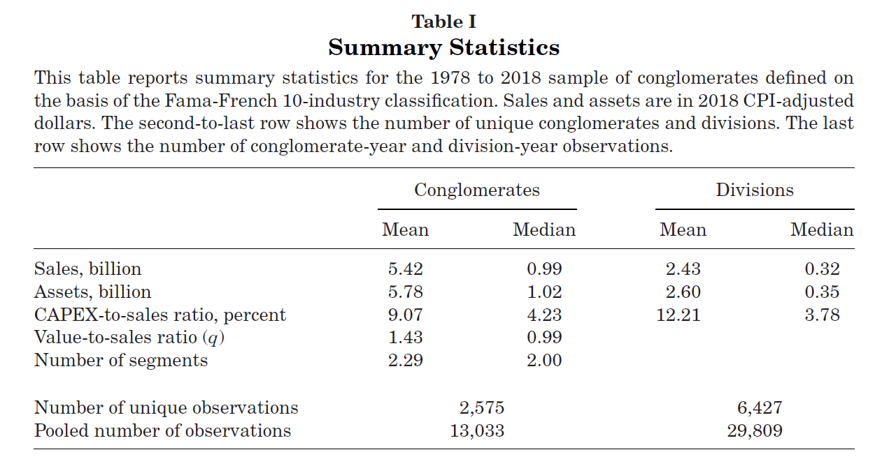

Slide 8
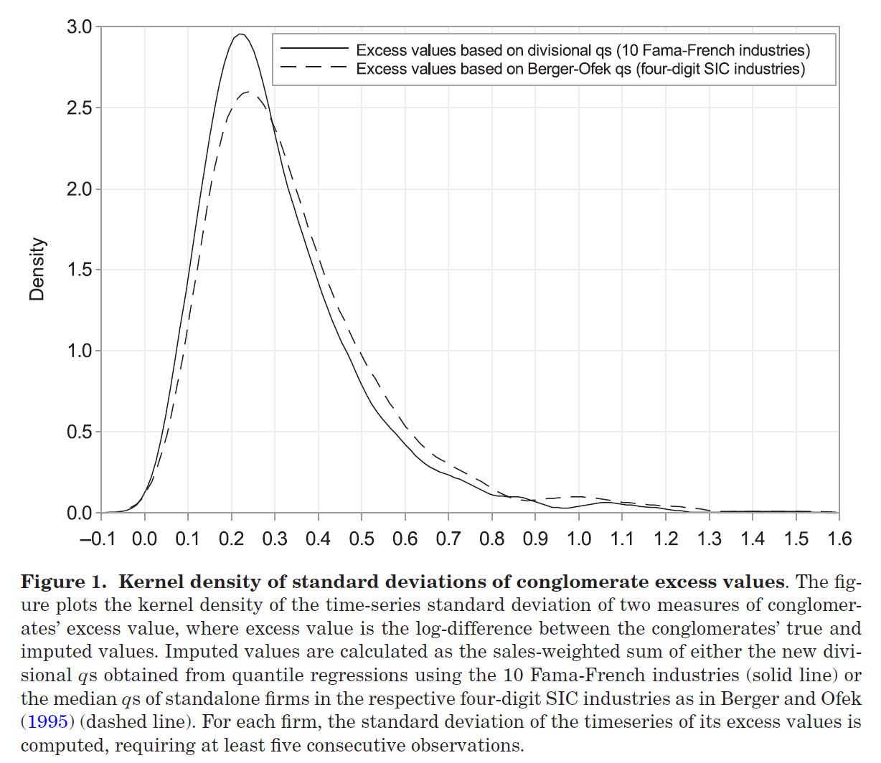
Notes:
The figure clearly shows that our method results in excess value estimates with a lower standard deviation than the estimates produced using the traditional approach of Berger and Ofek.
This evidence suggests that, despite being defined at a coarser industry level, the new estimates of intra-conglomerate qs more closely approximate the true conglomerate value than the standard industry-median qs of standalone firms.

Slide 9
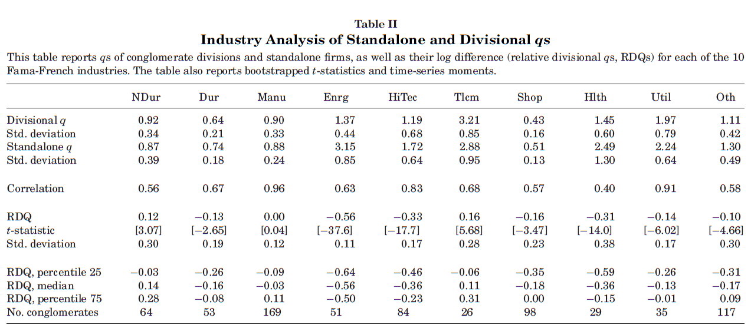
Notes:
The valuation multiples of conglomerate divisions are significantly different from those of standalone firms.
The valuation multiples of divisions relative to standalone firms vary considerably across industries.

Slide 10
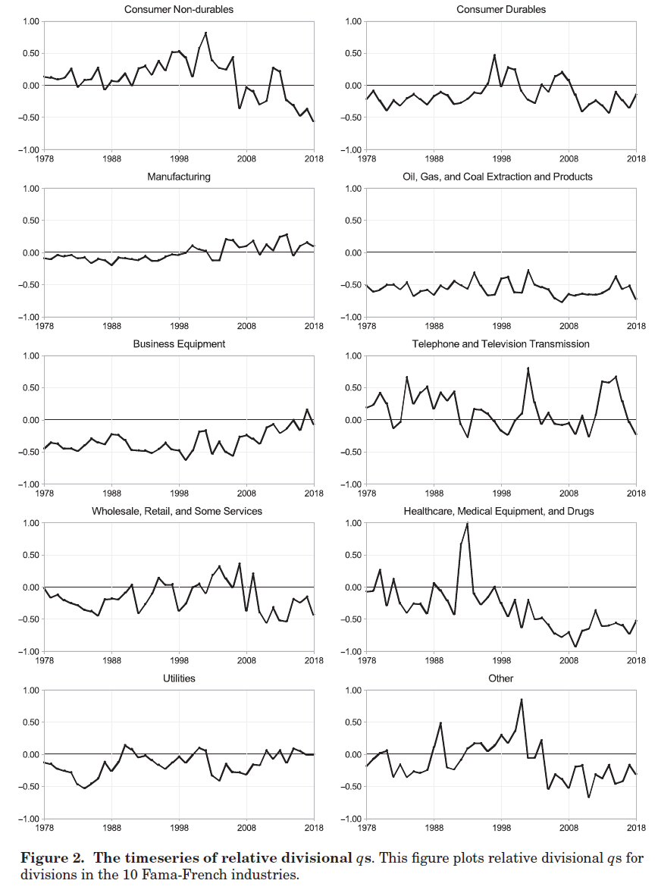
Notes:
considerable within-industry variation in RDQs over time

Slide 11
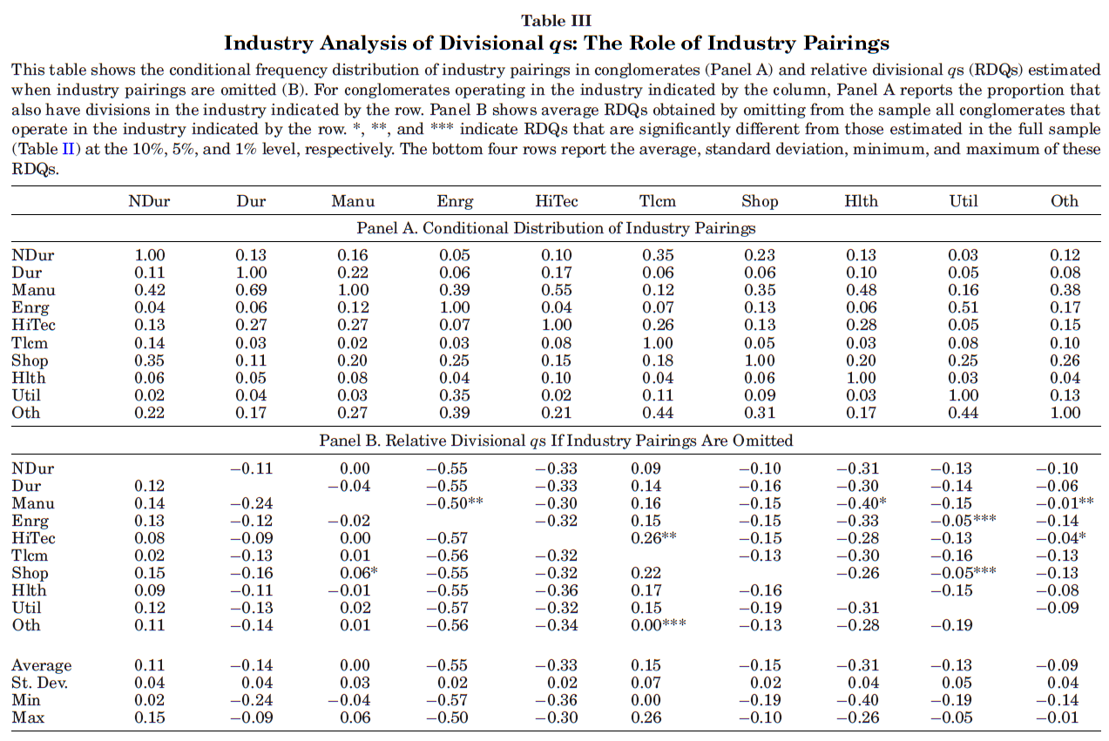
Notes:
Panel A: A conglomerate’s choice of industries is nonrandom.
Panel B:
First row indicates when the sample is limited to conglomerates that do not operate in the nondurables sector, divisions in the durables industry have estimated qs that are 11% smaller than those of standalone firms.
Overall, this evidence suggests that the endogenous within-conglomerate industry matching does not have a material effect on our estimates.

Slide 12
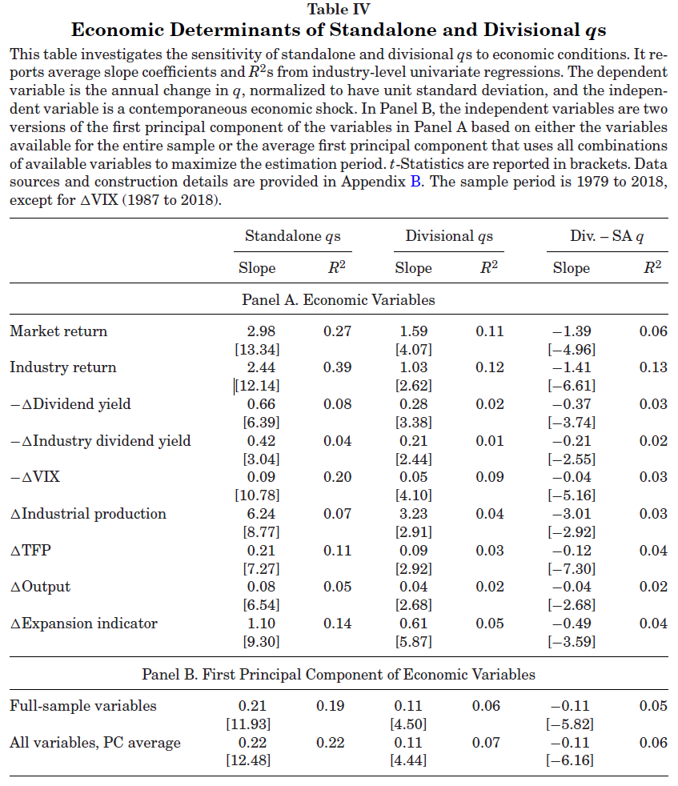
Notes:
Divisional qs are less sensitive to aggregate economic conditions than standalone qs

Slide 13
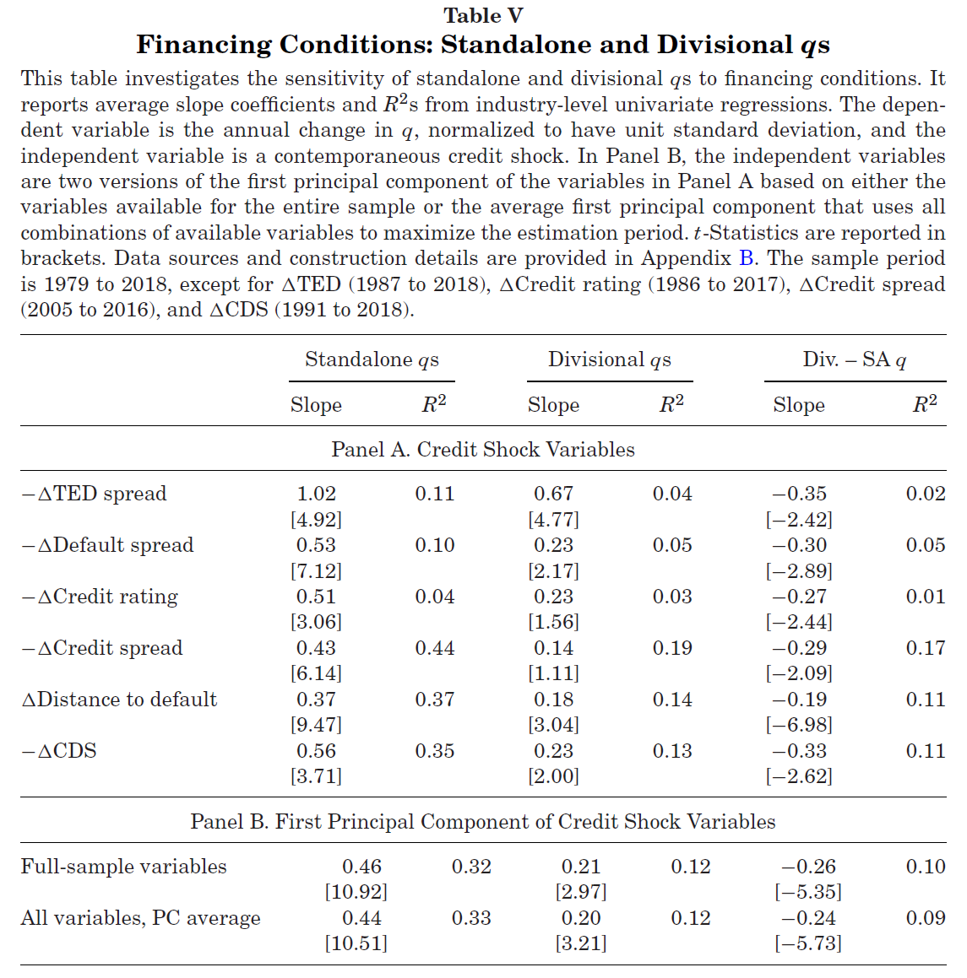
Notes:
qs of conglomerate divisions are significantly less sensitive to credit shocks than those of standalone firms.

Slide 14
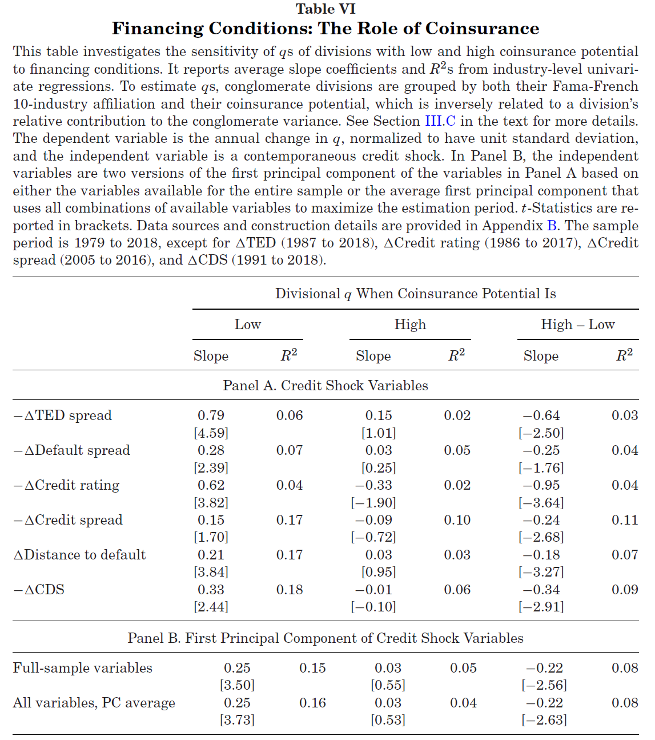
Notes:
High coinsurance potential means that a division has a low covariance with the other divisions.
External financing frictions play an important role in divisional qs through internal capital reallocation across unrelated divisions.

Slide 15
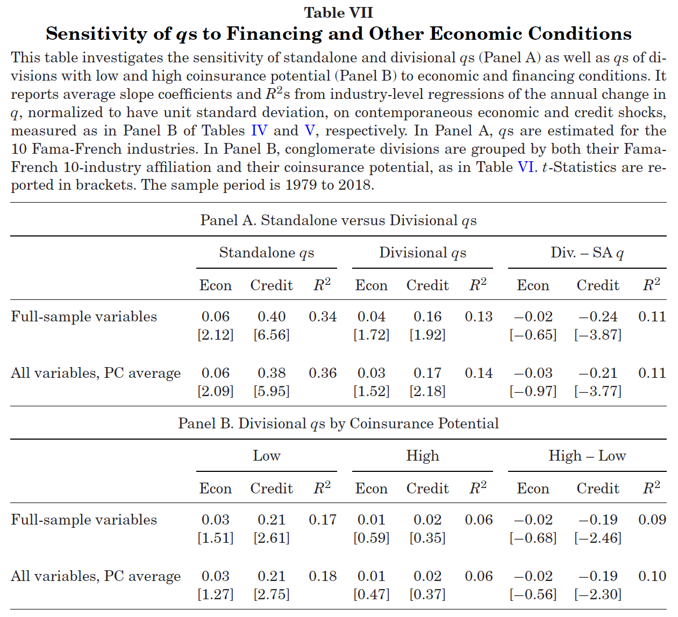
Notes:
After including credit shocks, other economic shocks do not help to explain the differences in the sensitivities.

Slide 16
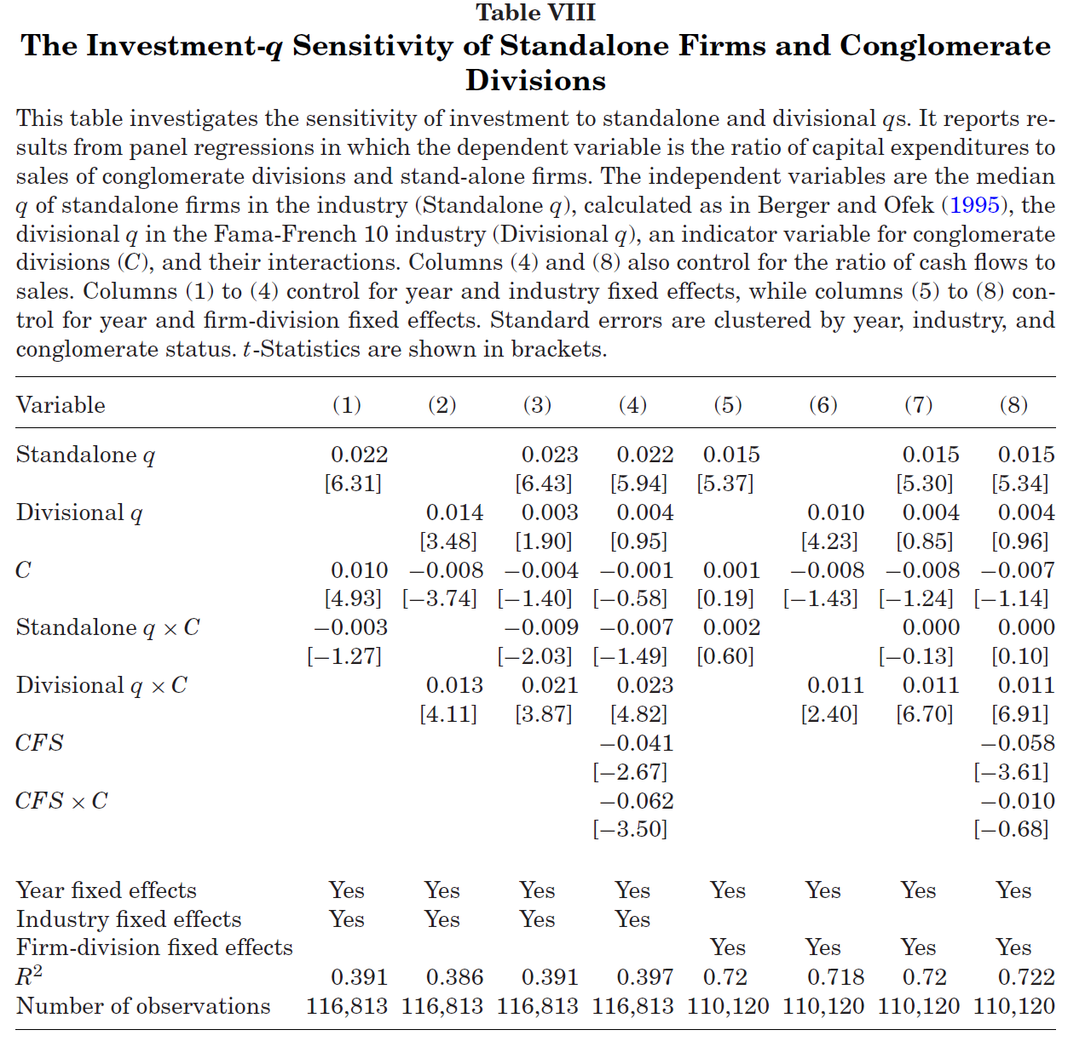
Notes:
Dependent variable: ratio of capex to sales of conglomerate divisions and standalone firms
Unlike divisional qs, standalone qs do not account for coinsurance and covariances across conglomerate divisions, and hence cannot fully explain conglomerate investment.
The interaction between Standalone q and C is mostly insignificant, suggesting that standalone q does not strongly impact investment in conglomerate divisions.
The interaction between Divisional q and C is positive and significant across all columns, suggesting that divisional q plays a more significant role in explaining investment in conglomerate divisions.

Slide 17
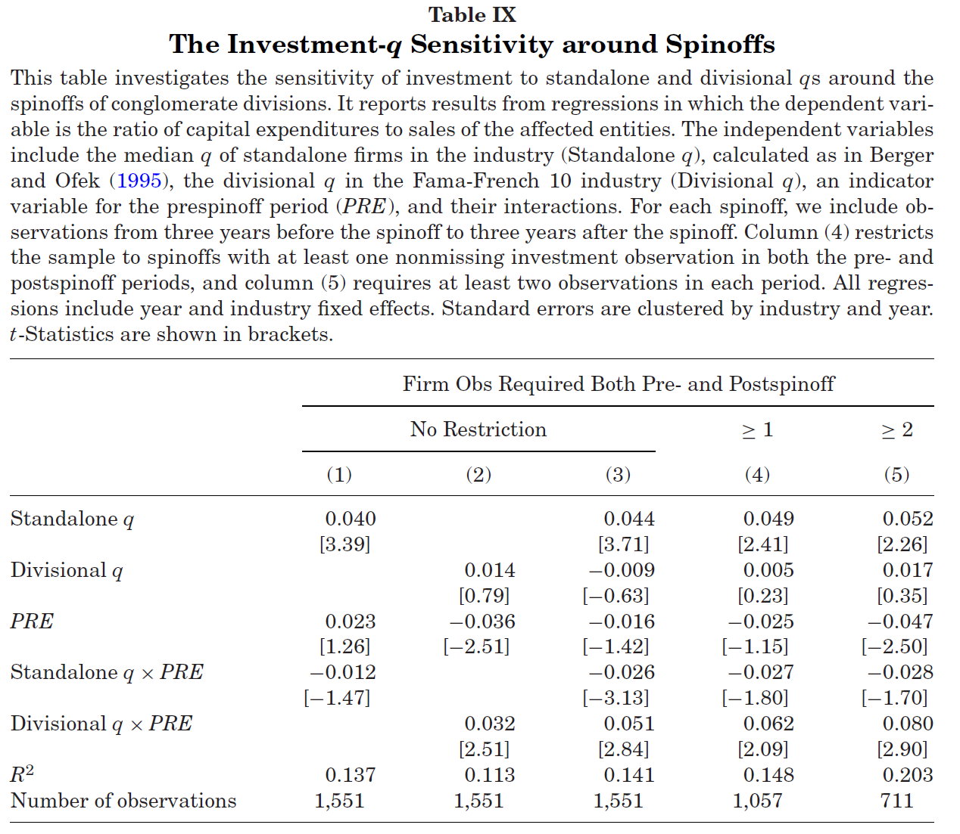
Notes:
Dependent variable: ratio of capex to sales of affected entities
Before the spinoff, divisional investment is highly related to qs estimated from conglomerates, whereas after the spinoff, it is only responsive to qs estimated from standalone firms.

Slide 18
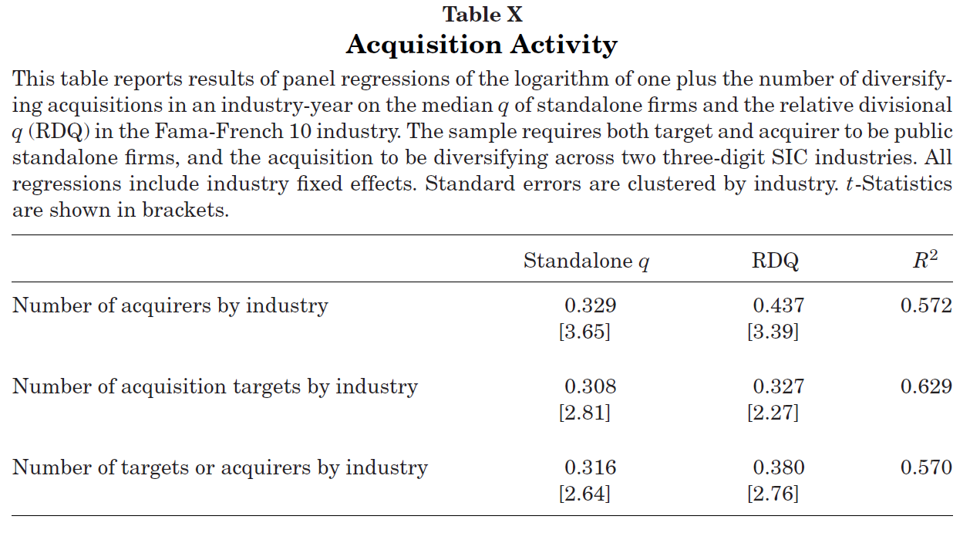
Notes:
The significantly positive and economically meaningful coefficients on RDQ suggest that higher values of conglomeration relative to focused organizational structures correspond to greater diversifying acquisition activity in the next year.

Slide 19
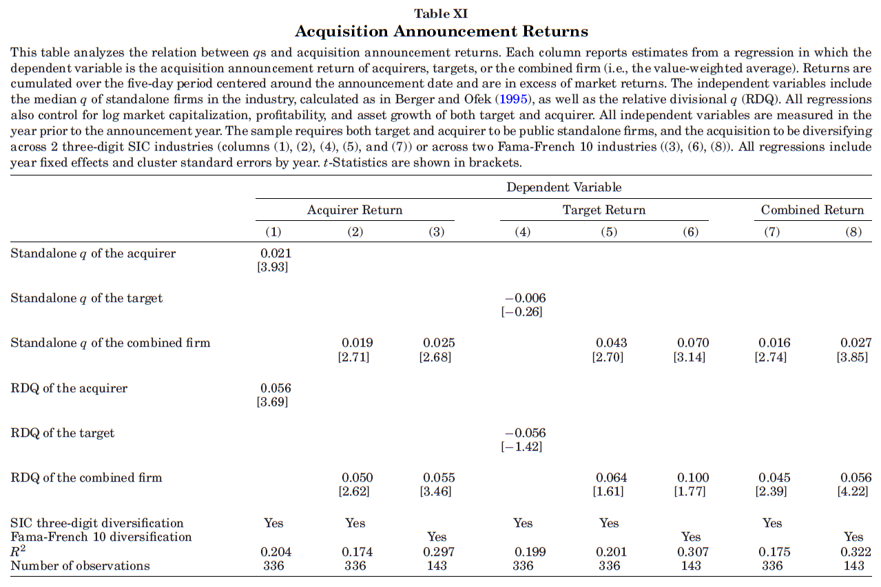
Notes:
RDQs positively predict announcement returns of diversifying acquisitions.

Slide 20
Conclusion
There are significant differences between divisional and standalone Tobin’s Q, with conglomerate divisions exhibiting lower sensitivity to economic and credit shocks.
Conglomerates effectively use internal capital reallocation to mitigate financial frictions, making divisions more resilient.
Prior research may mischaracterize conglomerates by relying on standalone Qs, which do not capture intraconglomerate dynamics.
These findings challenge the traditional “diversification discount” narrative, suggesting conglomerates have valuable economic mechanisms through internal capital markets.

